Slide 1
Test Patterns
Similar in concept to design patterns
Dozens of patterns out there
Will only focus on a few basic patterns to give us a taste
Key test pattern is Arrange-Act-Assert
Arrange: Setup everything needed for the running the code to be tested
Act: Invoke the code to be tested
Assert: Specify the criteria for the test to pass
As this is a design course, we will also look at design-for-testability patterns
Dependency Injection
Humble Object
Test Hook
Notes:
<*s*o*u*r*c*e*>*9*4*4*a*0*-*7*-*4*<*/*s*o*u*r*c*e*>

Slide 2
Test Patterns: Dependency Injection
Dependency Injection allows the normal coupling between a unit of code and its dependencies to be simulated during automated testing
Avoid hard-coding classes so we can pass in the dependency
Dependency becomes part of the application’s API
Can include it as an argument with each method call, or
Include it on the constructor, or make it a settable attribute
Use Dependency Injection so we can use Test Doubles
A simplified version of object or procedure to facilitate testing
Behaves like the real one
Designing for Dependency Injection
Supports Dynamic Binding
Supports TDD & ATDD
Notes:
<*s*o*u*r*c*e*>*9*4*4*a*0*-*7*-*5*<*/*s*o*u*r*c*e*>

Slide 3
Test Patterns: Dependency Injection
DependentClass: Dependency is injected via the “Dependency” property
IDependency: The Interface to the dependency
Dependency: The test double (Mock or Stub) for the dependency to be injected
Will be replaced by the dependency itself once its coded
Notes:
<*s*o*u*r*c*e*>*9*4*4*a*0*-*7*-*6*<*/*s*o*u*r*c*e*>
Image created by T.Guay

Slide 4
Test Patterns: Mocks and Stubs
Stubs mimic the dependency’s behavior via returning hard-coded values
Never causes the test to fail
Usually hand-coded
Mocks are more dynamic and are programmed to respond to the sequence of calls made to it
So can test how the dependent object is called
Simulates the dependent object’s behavior
Mocks can make the test fail, if expected interaction doesn’t occur
Usually created using mocking frameworks, such as Mockito or Moq
Beware of overusing Mocks when Stubs will do just as well for injecting
Notes:
<*s*o*u*r*c*e*>*9*4*4*a*0*-*7*-*7*<*/*s*o*u*r*c*e*>

Slide 5
Test Patterns: Humble Object
Used to make code more testable by extracting it into a decoupled component
Solution to testing tightly coupled components and asynchronous objects
Or bypassing the UI
Implement by
Extracting the logic from the hard-to-test component into a component that is testable via synchronous tests
Component implements a service interface consisting of methods that expose the logic of the untestable component
Only difference is that these methods are accessible via synchronous method calls
Humble Object becomes a very thin adapter layer that contains very little code
Retrieves any information required and passes on it to the testable component
Notes:
<*s*o*u*r*c*e*>*9*4*4*a*0*-*7*-*7*<*/*s*o*u*r*c*e*>

Slide 6
Test Patterns: Humble Object
Notes:
<*s*o*u*r*c*e*>*9*4*4*a*0*-*7*-*7*<*/*s*o*u*r*c*e*>

Slide 7
Test Patterns: Test Hook
Used to replace the dependencies at runtime
Last resort if other three patterns are not viable
Such as dealing with hard-coded dependencies
Non-object oriented languages
Implementation
Put a hook directly into the unit under test or into a dependency
Use a test flag to switch on the hook
Divert control to a test double (Mock or Stub) instead of the real object, or
Be the test double within the real object, or
Be a test-specific decorator that delegates to the real object when in production
Notes:
<*s*o*u*r*c*e*>*9*4*4*a*0*-*7*-*8*<*/*s*o*u*r*c*e*>

Slide 8
Test Completeness and Correctness
Test completeness and correctness is key to
Delivering value to the customer
Reducing software total cost of ownership (TCO)
Improving overall quality
Need to look at three areas
Requirements coverage—has the software been tested against all requirements?
Structural coverage—has each element of the software been tested?
Architectural coverage—have the control and data links been tested?
Following mnemonics describe best practices
Right-BICEP
CORRECT
Notes:
<*s*o*u*r*c*e*>*9*4*4*a*0*-*7*-*1*1*<*/*s*o*u*r*c*e*>

Slide 9
Test Completeness and Correctness: Right BICEP
Initial | Meaning | Approach
Right | Are the results right? | Use data files, test oracles, etc.
B | Boundary conditions correct? | Conformance, Ordering, Range, Reference, Existence, Cardinality, Time
I | Check the Inverse condition? | Apply logical inverse
C | Cross-check the results? | Try alternative ways to get the result
E | Enforce error conditions to happen? | Understand what error can occur
P | Performance characteristics in bound? | Test performance characteristics
Notes:
<*s*o*u*r*c*e*>*9*4*4*a*0*-*7*-*1*2*<*/*s*o*u*r*c*e*>
Instructors Notes:
Ask, how these can be applied to design?

Slide 10
Test Completeness and Correctness
Right BICEP violation example
What happens if the order is $30?
What is the Right BICEP violation?
Business Rule: Free standard shipping on orders of $30 or more
Test Scenario #1:
Given order is greater than $30
When Standard Shipping is Selected
Then Shipping Charge is $0
Test Scenario #2:
Given order is less than $30
When Standard Shipping is Selected
Then Shipping Charge is $5
Notes:
<*s*o*u*r*c*e*>*9*4*4*a*0*-*7*-*1*1*<*/*s*o*u*r*c*e*>
Instructors Notes:
Boundary condition violation

Slide 11
Test Completeness and Correctness: CORRECT
Initial | Meaning | Approach
C | Conformance | Are all specific data formats validated? What if they are different?
O | Ordering | Is the data order or position validated?
R | Range | Indices validated?
R | Reference | Any preconditions? Dependencies? Does the postcondition need to be validated?
E | Existence | Does the existence of something need to be validated?
C | Cardinality | Cardinalities validated?
T | Time | Relative time, absolute time, and concurrency validated?
Notes:
<*s*o*u*r*c*e*>*9*4*4*a*0*-*7*-*1*3*<*/*s*o*u*r*c*e*>
Instructors Notes:
Ask, how these can be applied to design?

Slide 12
Test Completeness and Correctness
CORRECT violation example
What is the CORRECT violation?
Business Rule: 20% Discount for first time customers on orders over $20
Test Scenario #1:
Given total order is $30
When Checkout Selected
Then Shipping Charge is $0
Notes:
<*s*o*u*r*c*e*>*9*4*4*a*0*-*7*-*1*1*<*/*s*o*u*r*c*e*>
Instructors Notes:
Existence violation as no check if customer first time

Slide 13
Apply Right-BICEP and CORRECT to Design
Can use to validate design
We ask these Right-BICEP and CORRECT questions about our design
Does our design support these factors?
Does our design support testing for these factors?
Remember our tests drive our design
Notes:
<*s*o*u*r*c*e*>*9*4*4*a*0*-*7*-*1*4*<*/*s*o*u*r*c*e*>
Instructors Notes: As this is not a test course, we will only give a brief overview of these techniques

Slide 14
Testing Tests
TDD and ATDD has test testing built into the process
For new code the first step is to write a failing test
If the test passes with no code written then there is something wrong with the test
After sufficient code is written, the test will pass
Thus your test is validated
For existing code and/or tests it is necessary to use a mock or stub to force the test to fail then mock or stub to see if the test passes
Or you can break the code to see if the test fails
Complex tests can be peer-reviewed or reviewed by a Test SME
Use Right BICEP and CORRECT as validation criteria
Test utility code should be unit tested
Notes:
<*s*o*u*r*c*e*>*9*4*4*a*0*-*7*-*1*6*<*/*s*o*u*r*c*e*>
Instructors Notes: As this is not a test course, we will only give a brief overview of these techniques

Slide 15
Reducing the Number of Test Conditions and Duplication
Key to maintainable test suites and speed of testing
Reduces or eliminates test duplication
Can use these techniques on existing tests to uncover duplicate coverage
Will look at
Equivalence Partitioning
Boundary Value Analysis (BVA)
All-Pairs
Goals are
To reduce the number of tests
Select test cases that will cover all the scenarios
Eliminate duplicate conditions tests
Apply to design by reducing the number of branches in your code
Do we really need complex switches in monolithic classes
Better to break up into small simple classes
Notes:
<*s*o*u*r*c*e*>*9*4*4*a*0*-*7*-*1*4*<*/*s*o*u*r*c*e*>
Instructors Notes: As this is not a test course, we will only give a brief overview of these techniques

Slide 16
Equivalence Partitioning
Use when SUT’s input domain is too large for testing all conditions
Partition into a number of subdomains
Subdomains are known as equivalence class
A source for one or more test input
First Identify the partitions
Notes:
Images created by T.Guay
Instructors Notes: As this is not a test course, we will only give a brief overview of these techniques

Slide 17
Equivalence Partitioning
Input class types are Valid and Invalid
Don’t need to test every possible input value
Only one from Valid and Invalid classes
And test for error condition if relevant
Example; It takes a score of 80 or higher to pass the Java Master exam
So only need to test one value >79 to test pass class
And one value <80 to test fail class
For each equivalence class write one test and only one test input
Known as partition testing
Goal to have one test and one input for each class
If two or more partitions overlap, then select valid inputs that fall into the overlap
Partition A range =1-120, Partition B range =110-150
Use an single input value that fall in the overlap range 110-120
Notes:
Instructors Notes: As this is not a test course, we will only give a brief overview of these techniques

Slide 18
Boundary Value Analysis
Generate test cases by looking at boundary values
End up with three equivalence classes
The boundary
Above boundary
Below boundary
Example: Integers results in the following classes
< 0 – One input value would be selected from any negative integers
0 – input value would be only 0
> 0 – One input value would be selected from any positive integers
Can also be applied for testing output values
Notes:
<*s*o*u*r*c*e*>*9*4*4*a*0*-*7*-*1*5*<*/*s*o*u*r*c*e*>
Instructors Notes: As this is not a test course, we will only give a brief overview of these techniques

Slide 19
All-Pairs
Only test two-way interactions
One of the more common causes of bugs
Also known as pairwise testing
Approach that executes a pairwise test data set
A set of test cases covering all combinations of values for every pair of input variables
Uses an orthogonal array
Two-dimensional array where any two columns in the array receive an even distribution of all pairwise combinations of values
Mitigates the combinatorial explosion by only testing two-way interactions
If you have three variables with three values, then you have 27 inputs to test
All-Pairs gets it down to 9 by only testing pairs
Notes:
<*s*o*u*r*c*e*>*9*4*4*a*0*-*7*-*1*6*<*/*s*o*u*r*c*e*>
Instructors Notes: As this is not a test course, we will only give a brief overview of these techniques

Slide 20
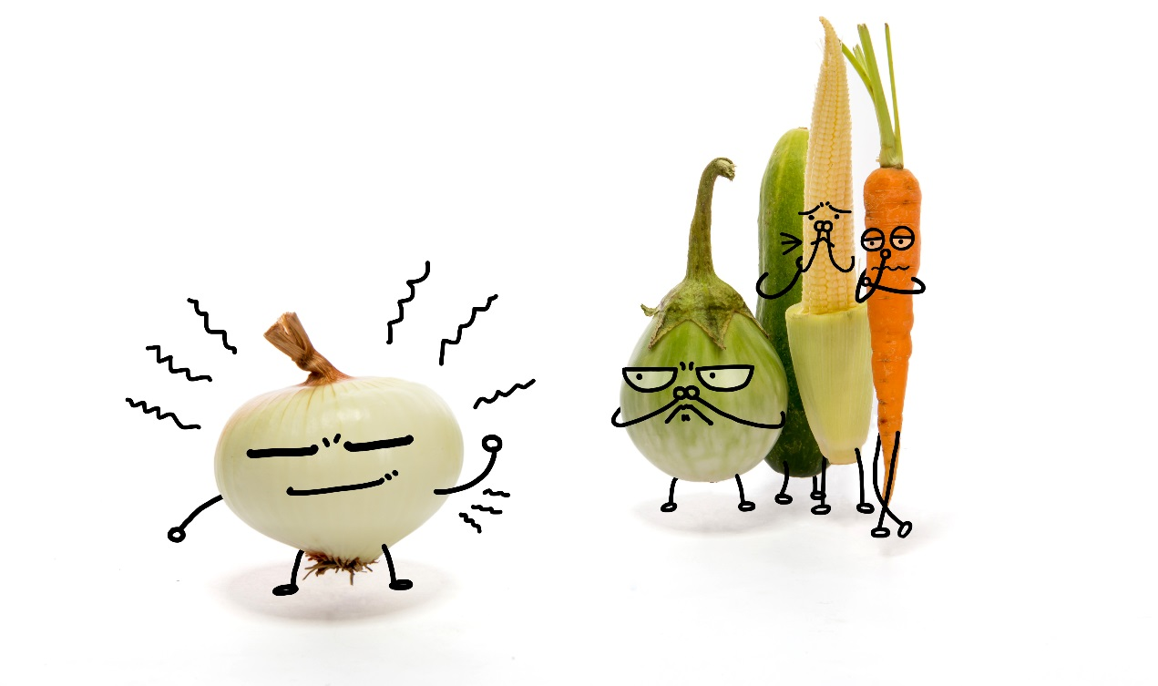
Test Smells and Refactoring
Test Code Smells: anti-patterns that a developer, tester, or coach may notice while reading or writing test code
Behavior Smells: cause tests to fail, or not compile at all
Project Smells: usually noticed by the Product Owner or the customer
Notes:
<*s*o*u*r*c*e*>*9*4*4*a*0*-*7*-*1*9*<*/*s*o*u*r*c*e*>

Slide 21
Test Code Smells
Test does not employ the Arrange-Act-Assert Pattern
Obscure Tests
Make it difficult to understand what behavior being tested
Increase the cost of test maintenance
Caused by either too much or too little information
Putting test code inline can create complex test methods
Conditional Test Logic
Test contains code that may not execute
Makes test more complicated and harder to validate
Interacts with the SUT indirectly via another object
Makes writing a correct test more difficult
Notes:
<*s*o*u*r*c*e*>*9*4*4*a*0*-*7*-*2*0*<*/*s*o*u*r*c*e*>

Slide 22
Test Code Smells
Duplicate test code
Increases the test code maintenance burden
Can result in unexpected results
Production code contains logic that should be exercised only during tests
Unexpected results in production if flag improperly set
Assertion roulette
Cannot determine which assertion failed
Tests behave erratically
May either pass or fail with the same test data
Notes:
<*s*o*u*r*c*e*>*9*4*4*a*0*-*7*-*2*1*<*/*s*o*u*r*c*e*>
Instructors Notes:
See http://www.around.com/ariane.html for an example of the consequences

Slide 23
Test Code Smells
Do Now
What smell does this test have?
public void testDroneFlightsByFromDroneCenter_Outbound()
throws Exception {
loadDroneFlightsFromFile("test-drone-flights.csv");
List droneFilghtsAtOrigin = facade.getFlightsByOriginCenterCode( ”KAL1");
assertEquals( 1, flightsAtOrigin.size());
DroneFlight firstFlight = (DroneFlight) droneFlightsAtOriginCenter.get(0);
assertEquals( ”KA1", droneFlight.getOriginCenter());
}
Notes:
<*s*o*u*r*c*e*>*9*4*4*a*0*-*7*-*2*0*<*/*s*o*u*r*c*e*>
Instructor Note:
It is an Obscure Test
The test reader is not able to see the cause and effect between fixture and verification logic because part of it is done outside the Test Method

Slide 24
Behavior Smells
Test fails to compile or run when a change is made in the application that doesn’t impact the code the test is exercising
Manual debugging is often required to determine the cause of test failures
Running the test requires manual intervention
Before the test is run
During the test run
Tests too slow
Code-test-fix cycle delays
CI build delays
Developers decide not to run the tests
Notes:
<*s*o*u*r*c*e*>*9*4*4*a*0*-*7*-*2*2*<*/*s*o*u*r*c*e*>
Instructors Notes: Remind them of Chapter 3 for info on good code and and refactor

Slide 25
Project Smells
Automated tests are buggy
Developers not writing tests
Test-last development
Legacy code
Tests too hard and too expensive to maintain
Takes time and resources away from new development
Too many bugs make it into the wild
Notes:
<*s*o*u*r*c*e*>*9*4*4*a*0*-*7*-*2*3*<*/*s*o*u*r*c*e*>
Instructors Notes: Remind them of Chapter 3 for info on good code and and refactor

Slide 26
Test Refactoring
Changes (transformations) of test code that
Do not add or remove test cases, and
Make test code more understandable and maintainable
We will look at seven refactorings
Inline Resource
Incorporate a resource into the test code to eliminate an external dependency
Set up a fixture in the test code to hold the same content as the resource
Set Up External Resource
If external resources are necessary, ensure the test that uses them sets up these resources before testing and releases them after the test executes
Make Resource Unique
Use unique identifiers for all allocated resources
Notes:
<*s*o*u*r*c*e*>*9*4*4*a*0*-*7*-*2*4*<*/*s*o*u*r*c*e*>
Instructors Notes: Remind them of Chapter 3 for info on good code and refactoring

Slide 27
Test Refactoring
Reduce Data
Minimize the data in the fixtures to the minimum needed
Add Assertion Explanation
xUnit assertions have an optional explanatory message argument to return when the assertion fails
Introduce Equality Method
For an object that needs to be checked for equality in tests, add an equals method for the object’s class
Break up the test into smaller tests
Notes:
<*s*o*u*r*c*e*>*9*4*4*a*0*-*7*-*2*5*<*/*s*o*u*r*c*e*>
Instructors Notes: Remind them of Chapter 3 for info on good code and and refactor

Slide 28
Resources
Further reading
’xUnit Test Patterns: Refactoring Test Code (Addison-Wesley, 2007) by Gerard Meszaros
Test Driven Practical TDD and Acceptance TDD for Java Programmers (Manning 2008) by Lasse Koskella
Notes:
<*s*o*u*r*c*e*>*9*4*4*a*0*-*7*-*4*<*/*s*o*u*r*c*e*>

